Slide 1


One-line Diagrams Revision of 9 April 2026
Dr. Norbert Doerry
http://doerry.org/norbert/MarineElectricalPowerSystems/index.htm
© 2026 by Norbert Doerry This work is licensed via: CC BY 4.0 (https://creativecommons.org/)

Slide 2
Essential Questions
What is a one-line diagram? | Remember
How is the one-line diagram used in an EPLA? | Understand
How does the level of detail depicted on a one-line diagram evolve during different stages of design? | Understand
What are the common symbols used in a one-line diagram? | Apply

Slide 3
Introduction
From U.S. Coast Guard Marine Safety Center Procedure E2-07:
“The purpose of an electrical one-line diagram is to provide an elementary schematic outlining connections from power sources (generators, shore power, battery banks) through a distribution system (switchboard, busbars, cables, feeders, and panels) to supply various power consuming loads.”

Slide 4
Introduction (continued)
The one-line diagram may incorporate additional information such as that required by 46CFR110.25 to include:
Type and size of generators and prime movers.
Type and size of generator cables, bus-tie cables, feeders, and branch circuit cables.
Power and lighting panelboards with number of circuits and rating of energy consuming devices.
Type and capacity of storage batteries.
Rating of circuit breakers and switches, interrupting capacity of overcurrent devices, and rating or setting of overcurrent devices.
Location (machinery room) of electrical equipment.
A one-line diagram may also be called a single-line diagram.

Slide 5
Introduction (continue)
For detail design, ABS MVR for example, requires a one-line diagram of main and emergency power distribution systems that shows:
“Generators: kW rating, voltage, rated current, frequency, number of phases, power factor.
Motors: kW or hp rating, voltage and current rating, remote stops (when required).
Motor controllers: type (direct-on-line, star-delta, etc.), disconnect devices, overload and under-voltage protections, remote stops, as applicable.
Transformers: kVA rating, rated voltage and current, winding connection.
Circuits: designations, type and size of cables, trip setting and rating of circuit protective devices, rated load of each branch circuit, emergency tripping and preferential tripping features.
Batteries: type, voltage, rated capacity, conductor protection, charging and discharging boards.”

Slide 6
One-line diagram properties
The lines representing the connections in a one-line diagram represent the power cables (or bus duct / bus pipe) connecting equipment
The cables can contain multiple conductors, and multiple cables may be paralleled.
A one-line diagram is more like a network diagram rather than a wiring diagram.
The level of detail provided in a one-line diagram evolves during the design process.
Depends on the needs of analyses being conducted.
More detail is provided as the design matures.

Slide 7
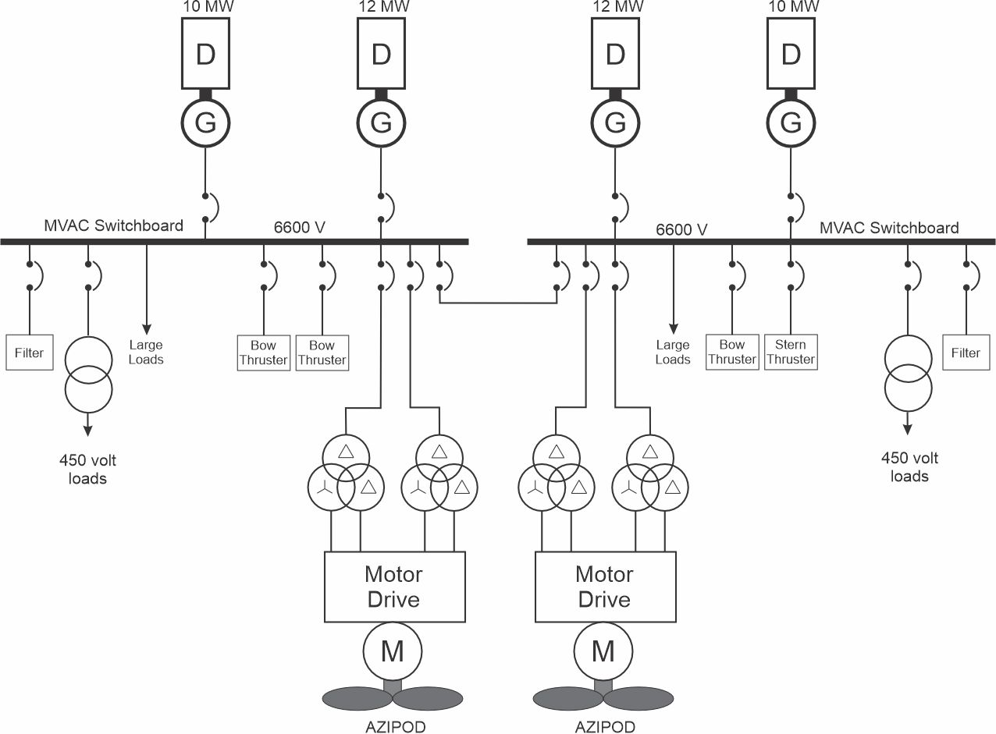
Example: Cruise Ship (Concept Study)

Slide 8
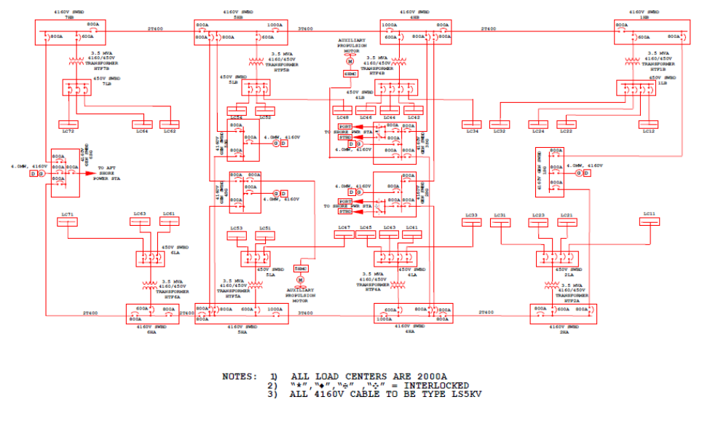
Example: USS Makin Island (LHD 8) (Preliminary and Contract Design)
Dalton, Thomas, Abe Boughner, C. David Mako, and CDR Norbert Doerry, "LHD 8: A step Toward the All Electric Warship", presented at ASNE Day 2002.

Slide 9
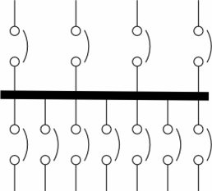
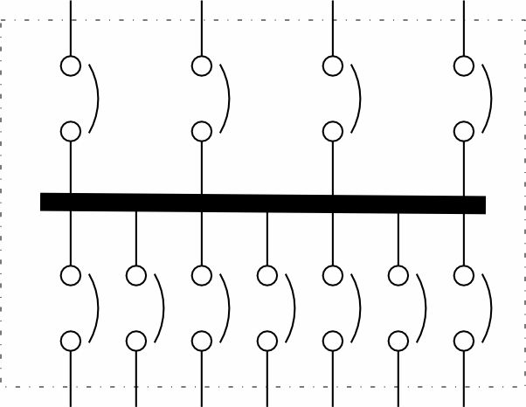
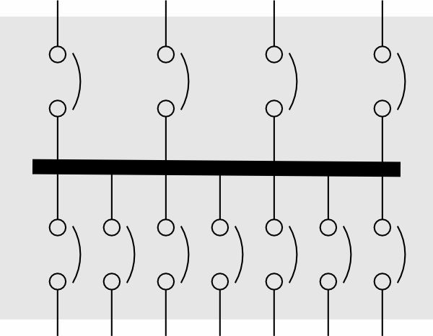
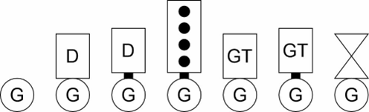


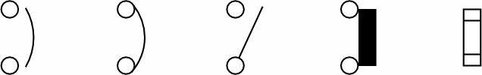
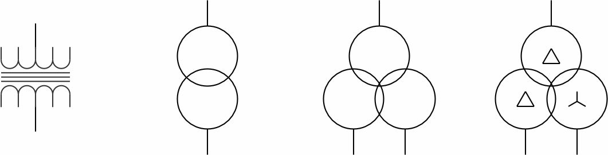
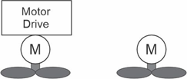

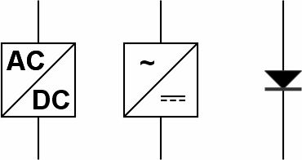
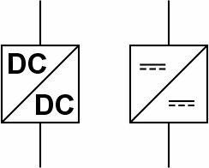

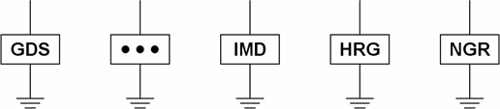
Common Symbols
Not standardized ….
Switchboards (Load centers, Power panels)
Generator sets
Circuit Interrupter
AC to AC
Converter
Inverter
Transformers
Propulsion Motor
Motor
Rectifiers
DC to DC
converters
Ground
Symbols
Grounding Equipment

Slide 10
Layout
Layout is not standardized; conventions commonly employed.
Multiple sheets may be used.
Traditional commercial power system (Cruise Ship Example).
Generator sets on top
Switchboards in middle
Loads at the bottom
Port switchboard on the left; Starboard switchboard on the right
Equipment in same space depicted near each other
Dotted or dashed lines may be used to depict space boundaries
Zonal power system (LHD 8 Example).
Equipment arranged by zone
Forward most zone on right; aft most zone on left
Dotted or dashed lines may be used to depict zone boundaries
If a line is intended to represent multiple connections to multiple loads (proxy load), then the connection to the switchboard may not include a circuit breaker; each load is understood to have its own circuit breaker.
First sheet should include a legend describing symbols used.

Slide 11
Level of detail to support EPLA
The electrical distribution system should be defined to the load center level (or the switchboard level if the design does not include load centers).
Facilitates assigning loads from the load list to the appropriate load center.
All power system equipment should have a unique identifier.
The unique identifier helps ensure that the EPS-CONOPS refers to the appropriate electrical power system component.
All bus-tie circuit breakers, generator circuit breakers, circuit breakers associated with energy storage, circuit breakers supplying large transformers / power conversion equipment, circuit breakers supplying switchboards and circuit breakers supplying load centers should have a unique identifier.
The trip rating for these circuit breakers should be depicted if known.
The unique identifier helps ensure that the EPS-CONOPS refers to the appropriate electrical power system component; the configuration of the electric plant for each operating condition can be defined without ambiguity.
Listing the trip rating can help ensure the circuit breakers are appropriately rated based on load flow analysis.
The cable type, cable number, and ampacity should be depicted for all cables connecting generator sets to the power system, energy storage systems to the power system, bus-ties, large transformers and large power electronic converters, and large loads.
If known, one should consider depicting the length of the cable.
This information is useful for modeling the cables in a load flow analysis.

Slide 12
Level of detail to support EPLA (continued)
For generator sets, the kW rating, kVA rating (or rated power factor), voltage, frequency, and number of phases should be depicted.
Helps ensure sufficient but not excessive generator set capacity is installed.
For transformers, the kW rating, kVA rating (or rated power factor), primary voltage, secondary voltage should be depicted.
Helps ensure sufficient but not excessive transformer capacity is installed.
For energy storage, the charge rate, discharge rate, voltage rating, and energy rating should be depicted.
Helps ensure sufficient but not excessive energy storage capacity is installed.
All large loads should have a unique identifier and the one line diagram should depict the kW connected load, and the kVA connected load (or rated power factor).
The unique identifier helps to ensure the proper load configurations are specified in the EPLA for each operating condition.
The connected load helps ensure cables and other power system equipment have sufficient capacity to serve these loads.

